Slide 1
Union Pacific & CP

Slide 2
BNSF

Slide 3
CSX

Slide 4
NS

Slide 5
CP

Slide 6
CN

Slide 7
KCS

Slide 8
Union Pacific System
Seattle
Eastport
Portland
Duluth
Twin Cities
Omaha
Chicago
Oakland
SLC
BNSF
Denver
KC
CN
St. Louis
CP
CSX
KCS
Memphis
NS
LA
UP
Calexico
Dallas
Nogales
El Paso
New Orleans
Eagle Pass
Houston
Laredo
Brownsville

Slide 9
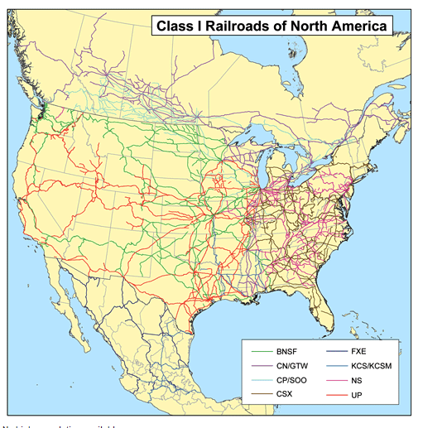
Class I Railroads in North America

