Slide 1
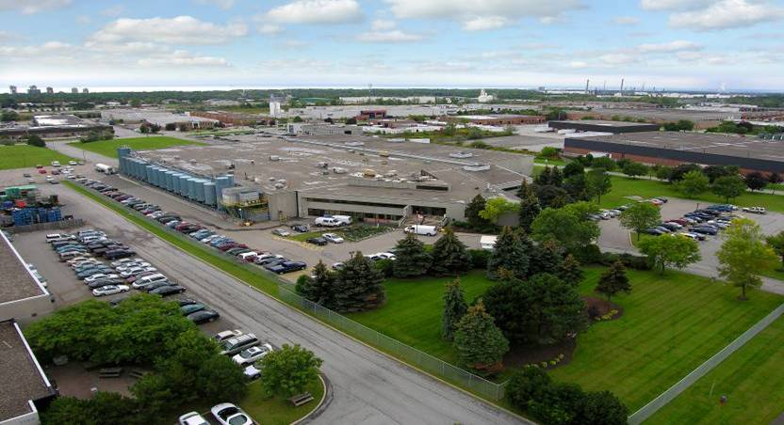
Take Our Kids to Work - Oakville

Slide 2
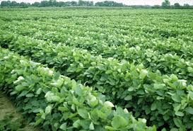
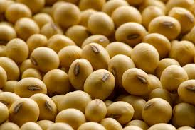
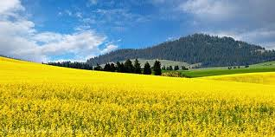
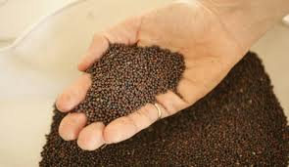
Soybeans and Canola Seeds Arrive in Hamilton

Slide 3
Bean Cleaning
SOYBEAN
EXTRACTION
(soybean ~ 18% oil)
Cooking
Cracking
Dehulling
Hulls
Flaking
Extraction
Extracted Oil
Degumming
Meal
Notes:
Bean Cleaning: Removes pods, stalks, stones, etc.
Cooking: Beans are heated to inactivate enzymes that are naturally present. Otherwise oil damage would occur. Heating also facilitates hull removal.
Cracking: Beans are cracked into 4 to 6 pieces. Hulls are now loose.
Dehulling: Hulls are removed by aspiration. They contain large amounts of fiber. Hull removal improves meal quality. Hulls are sold as a by-product.
Flaking: Bean pieces pass through rollers making a flake (like a corn flake). Oil bearing cells are opened.
Extraction: Oil removed by solvent extraction using hexane.
Meal: Soybean meal containing ~45% protein is sold for animal feed formulations.
Degumming: Oil is mixed with a small amount of water and centrifuged to remove phosphorus compounds (lecithin).

Slide 4
CANOLA SEED
EXTRACTION
(canola seed ~ 42% oil)
Seed Cleaning
Flaking
Cooking
Pressing
Press Oil
Degumming
Extraction
Extracted Oil
Meal
Notes:
Seed Cleaning: Removes pods, stalks, stones, etc.
Flaking: Seed passes through rollers making a small flake. Oil bearing cells are opened.
Cooking: Flakes are heated to inactivate enzymes that are naturally present. Otherwise oil damage would occur. Heating also reduces oil viscosity making pressing easier.
Pressing: ~55% of the oil is squeezed from cooked flakes in high pressure screw press.
Extraction: Balance of oil is solvent extracted using hexane.
Meal: Canola meal containing ~35% protein is sold for animal feed formulations.
Degumming: Press and extracted oils are combined. Oil is mixed with a small amount of water/acid and centrifuged to remove phosphorus compounds.

Slide 5
Degummed Oil
OIL PROCESSING
Alkali Refining
Bleaching
Hydrogenation
Blending
Other Oils
Deodorization
Notes:
Alkali Refining: Oil is mixed with acid and dilute caustic soda. Centrifugation removes free fatty acids, phosphorus compounds, and trace metals.
Bleaching: Oil is contacted with bleaching earth and subsequently filtered. Bleaching removes colour pigments, chlorophyll (especially in canola oil) and trace metals.
For salad/cooking oil production, bleached oil goes straight to deodorization.
Deodorization: Oil is subjected to high temperature under very low vacuum. This drives off volatile compounds that contribute to odour and flavour. A bland product is produced.
For shortening production, the bleached oil goes to hydrogenation.
Hydrogenation: Oil is combined with hydrogen gas under high pressure/high temperature in the presence of a nickel catalyst. This increases the melting point of the fat and increases oxidative stability.
Blending: Depending on the required product, various hydrogenated fats are blended to meet specifications.

Slide 6
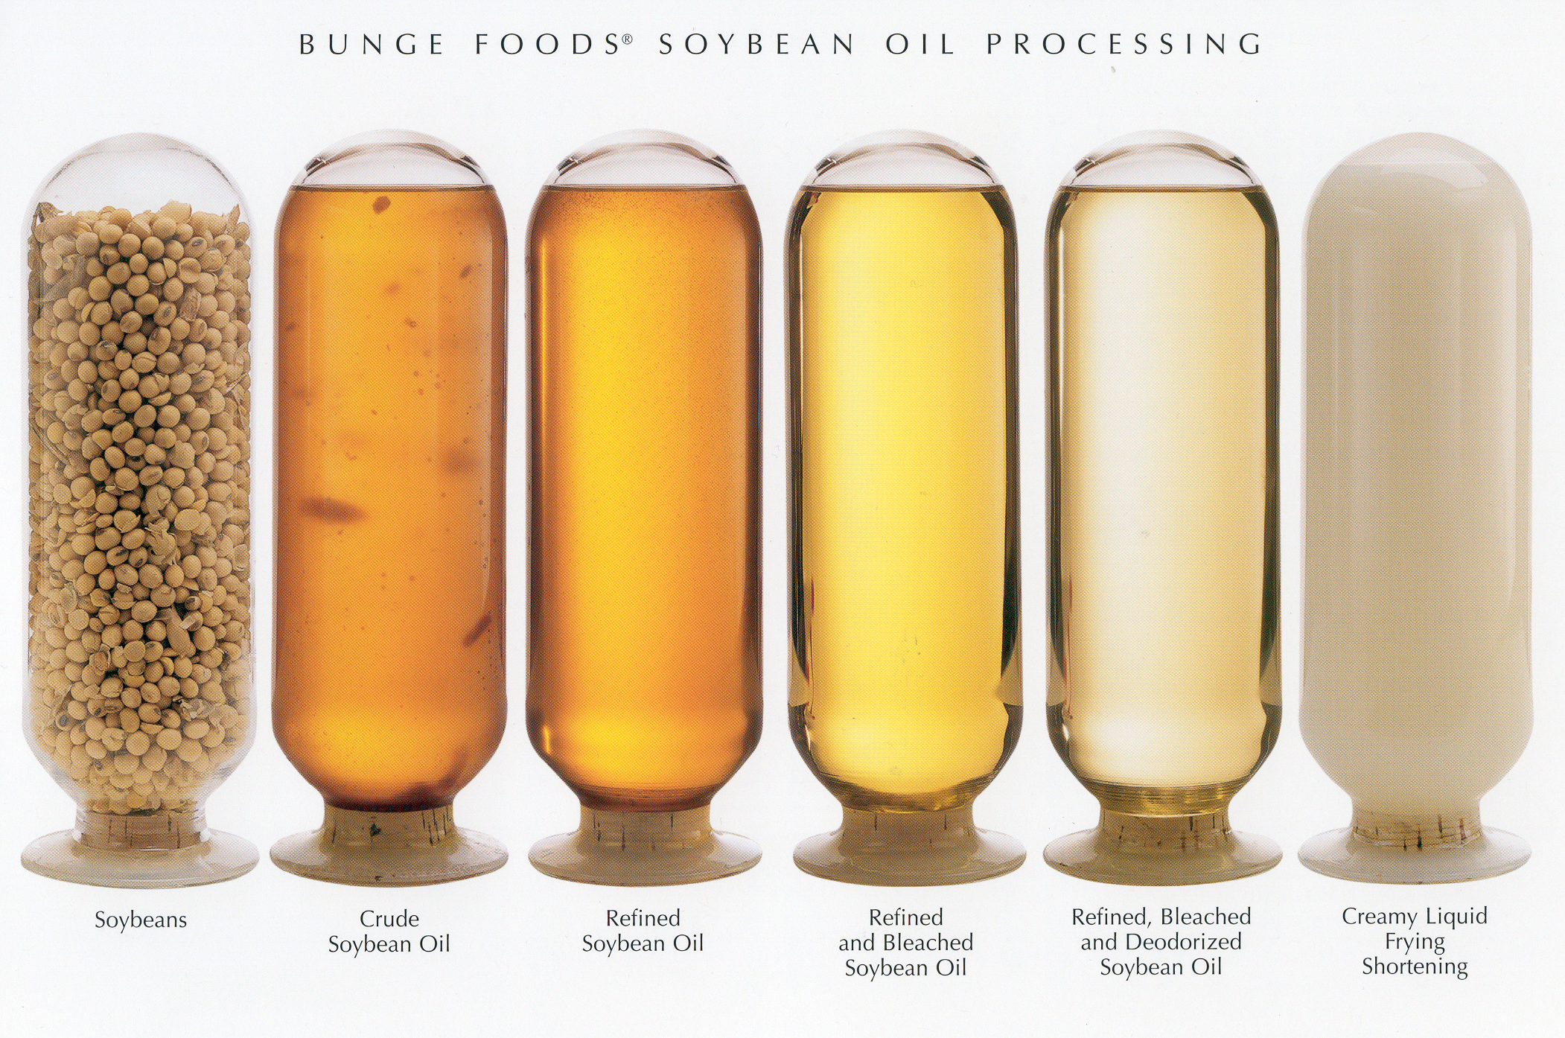
Soybeans and Canola Seeds are Processed in Hamilton

Slide 7
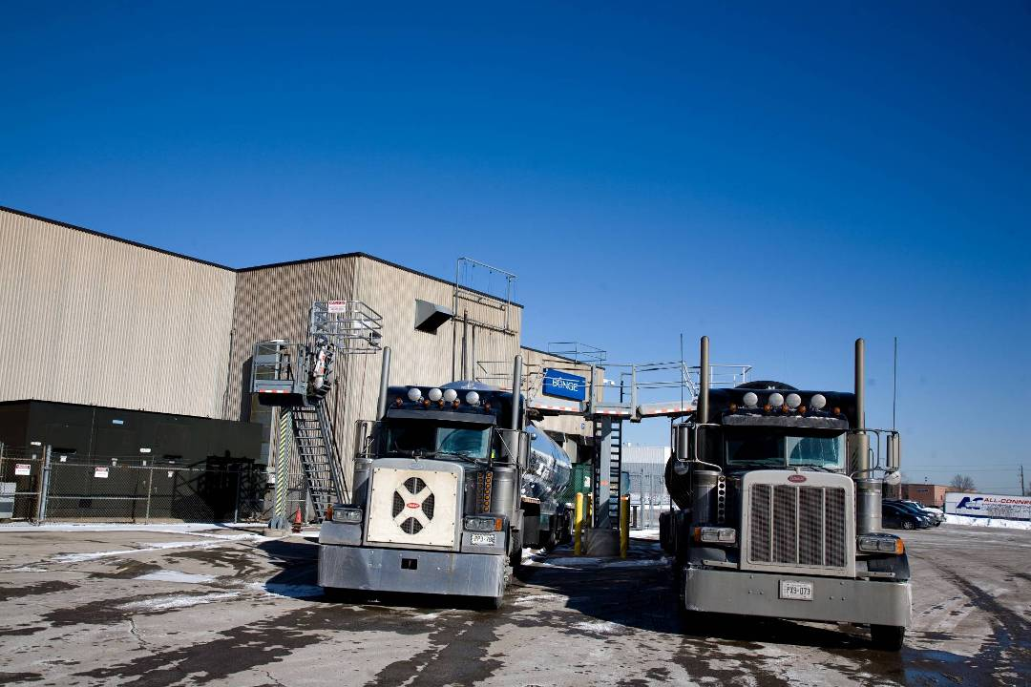
Arrives in Oakville
Refined, Bleached, Deodorized oil arrives in Oakville

Slide 8
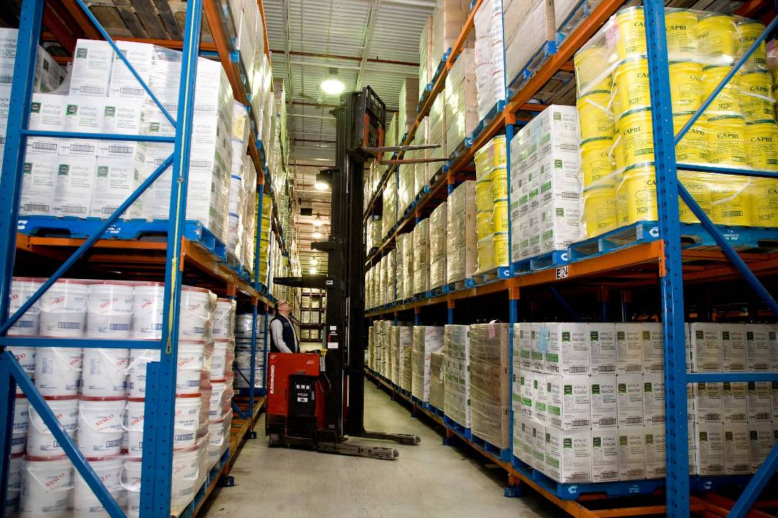
Leaves Oakville
Packaged Product leaves Oakville

Slide 9
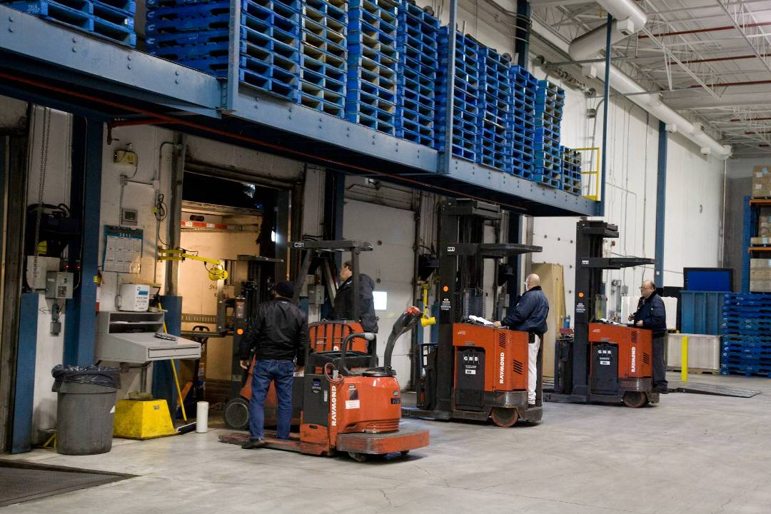
Leaves Oakville
Packaged Product leaves Oakville

Slide 10
Liquid Oils
Types
Canola
Soybean
High Oleic Canola Oil
  Nutra Clear
  Buttery Griddle Oil
  Popcorn Popping Oil
Mid Oleic Sunflower Oil

Slide 11
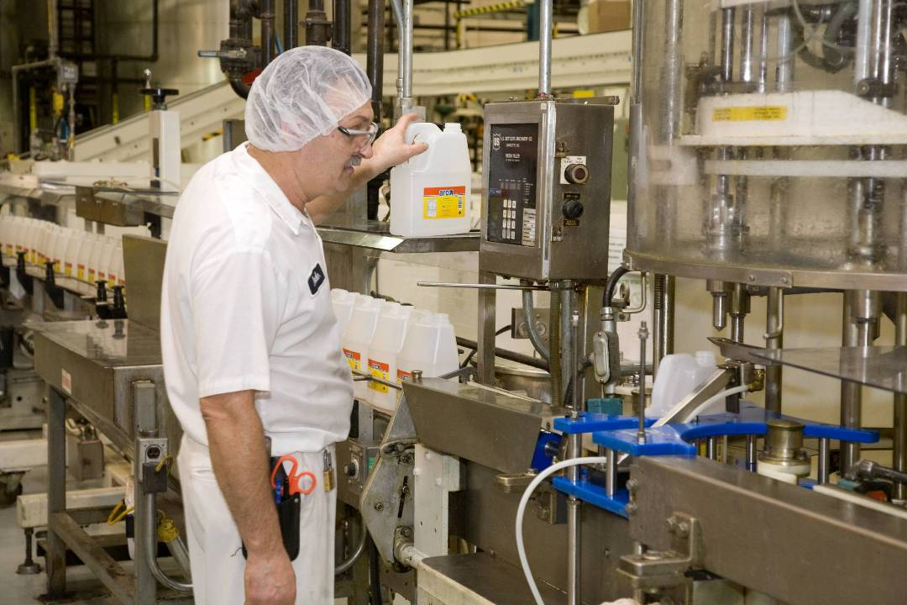
Liquid Oils
Package Formats – 3 & 5L Bottle

Slide 12
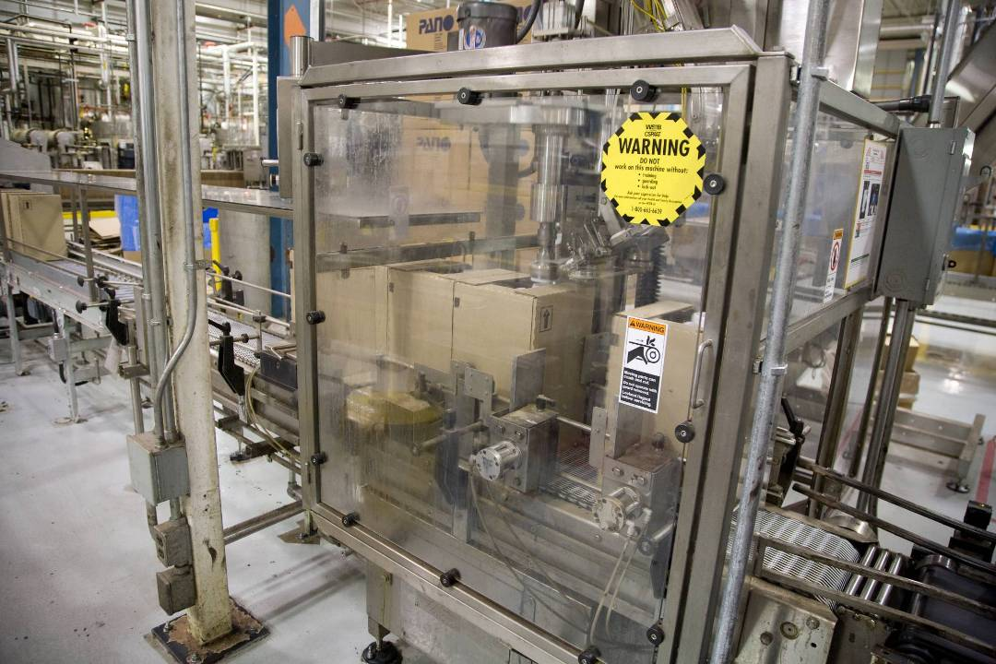
Liquid Oils
Package Formats – 16L JIB

Slide 13
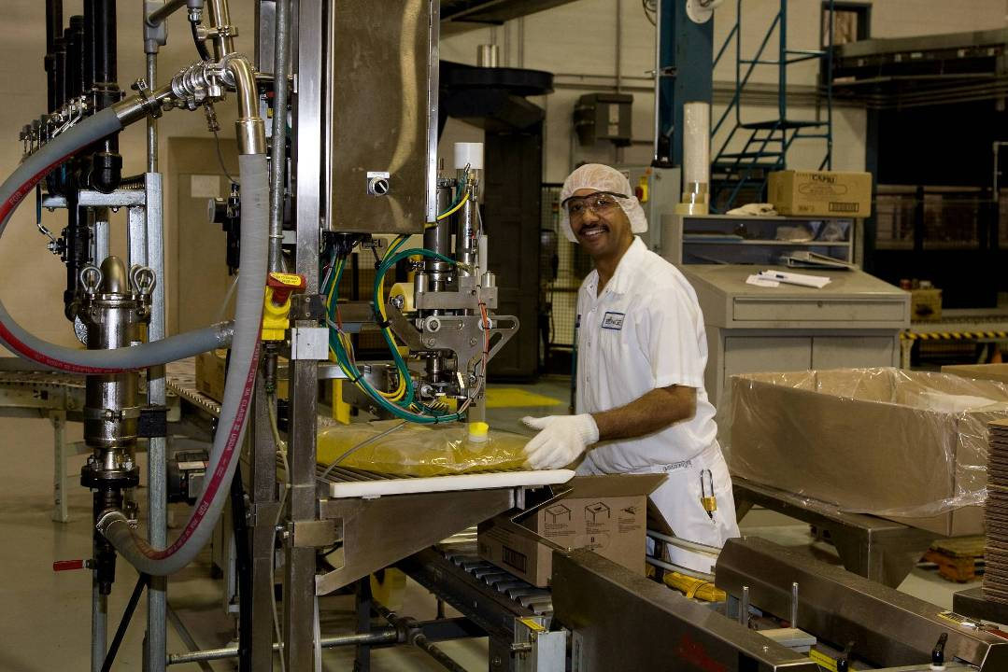
Liquid Oils
Package Formats – 16 L BIB

Slide 14
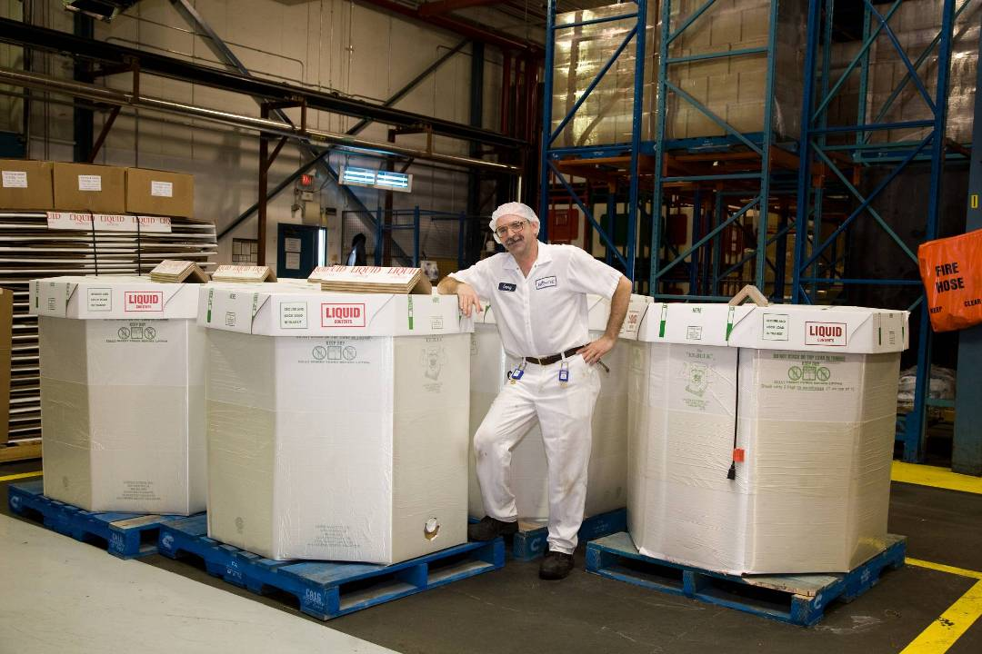
Liquid Oils
Package Formats – 900 kg NR Tote

Slide 15
Liquid Oils
Applications
Salad Dressing
Baking (eg Bread, Muffins)
Griddle and Popcorn Popping
Deep Frying

Slide 16
Solid Shortening
Types
Hydrogenated
  Soybean, canola, cottonseed and palm blends
Non Hydrogenated
  Soybean, canola, palm and palm kernel blends
Animal Fats
  Lard, tallow

Slide 17
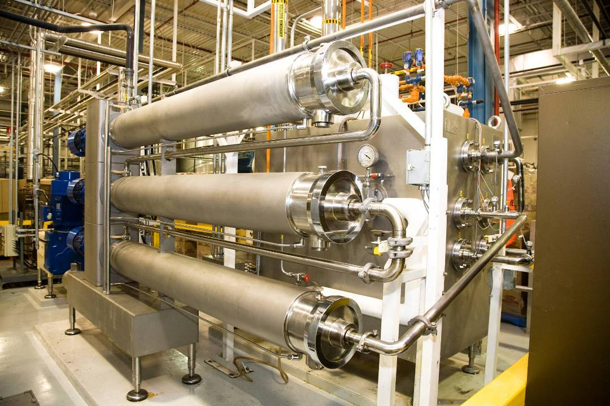
Solid Shortening Crystallizer
Change in State from liquid to solid

Slide 18
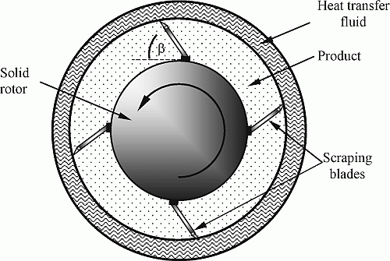
Solid Shortening
Crystallization Equipment – Cooling Barrel

Slide 19
Solid Shortening
Crystallization Equipment - Pinworker

Slide 20
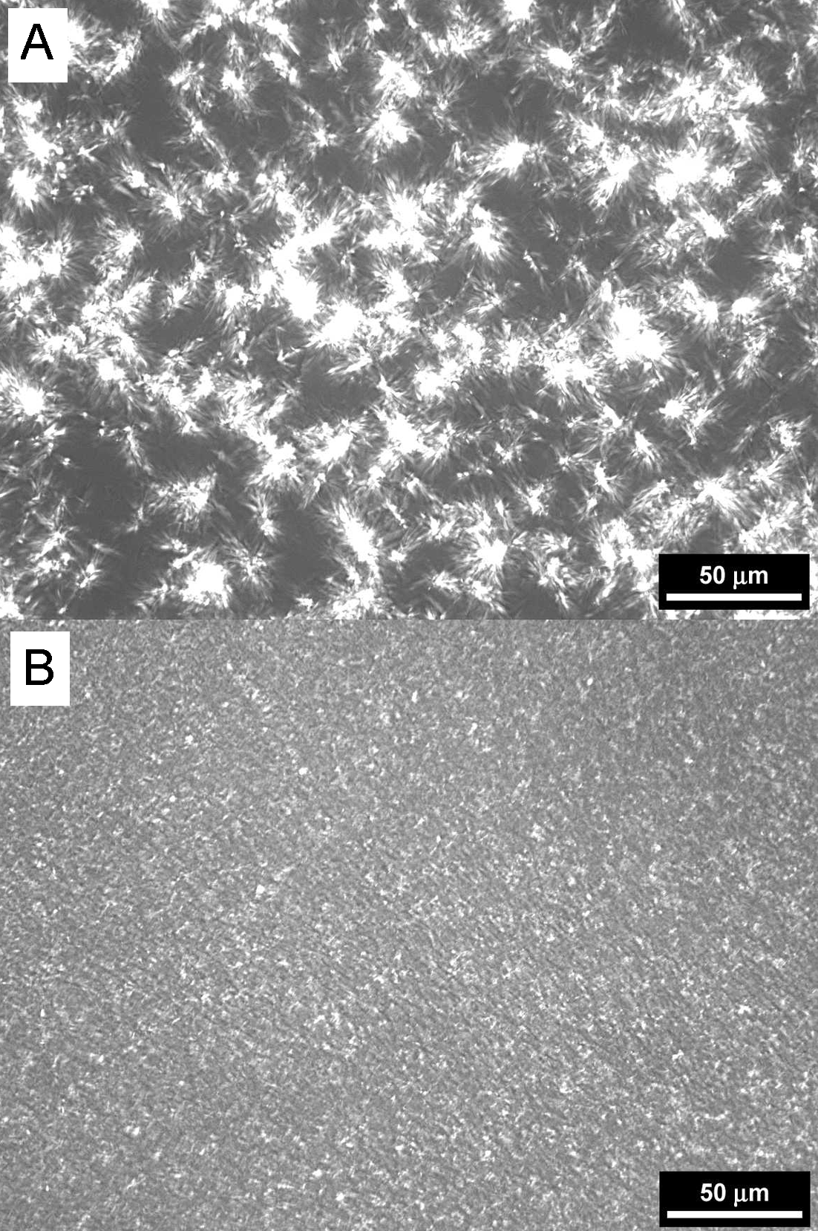
Solid Shortening
Cooling Rate and Crystallization
Slow Cooling Rate
Fast Cooling Rate
Fewer and larger crystals
↓ Surface area
↓ SFC
↓ Hardness
Many and smaller crystals
↑ Surface area
↑ SFC
↑ Hardness

Slide 21
Solid Shortening
Package Formats
1 # prints, 2.5 # tubs, 3# tubs
  Shortening
  Lard
20 kg and 50#
  Hydrogenated vegetable
  Non hydrogenated vegetable
  Lard
  Tallow

Slide 22
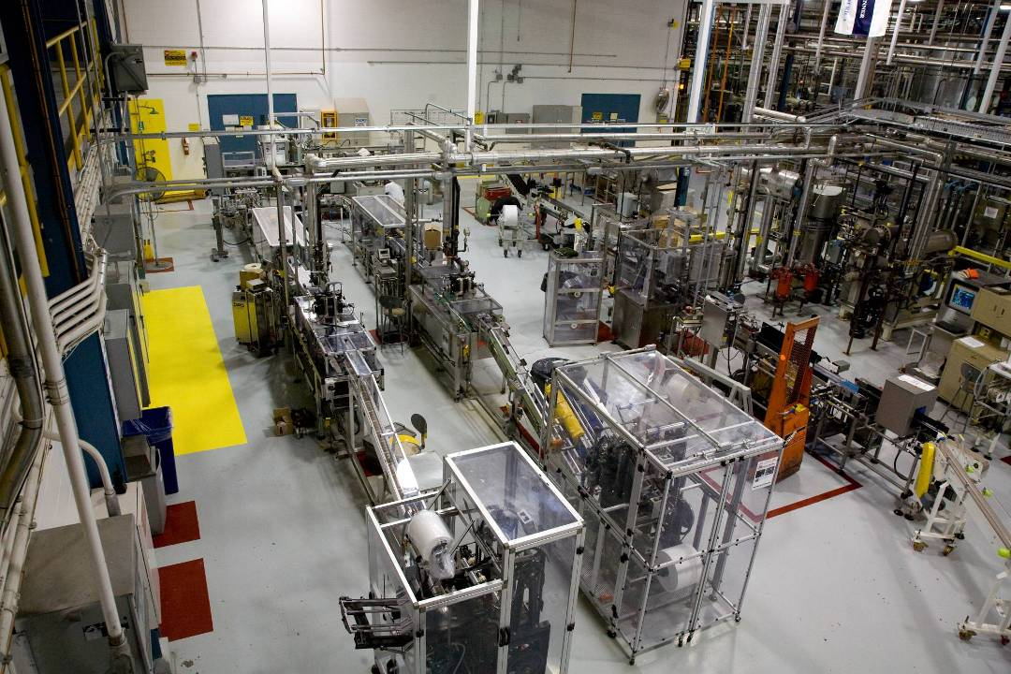
Solid Shortening
Package Formats – Retail Line

Slide 23
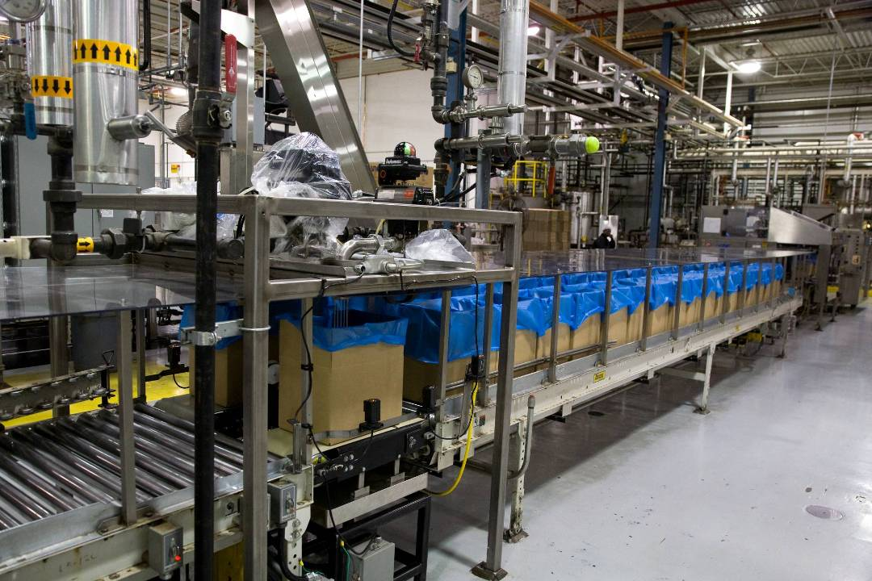
Solid Shortening
Package Formats – Cube Line

Slide 24
Solid Shortening
OXIDATIVE
STABILITY
NUTRITION
FUNCTIONALITY
Selecting a Type of Solid Shortening
The
Dream Fat

Slide 25
Solid Shortening
Determine your Objectives: Functionality
Although fats and oils share a common molecular structure…
…they fulfill different functions in a given formula or application

Slide 26
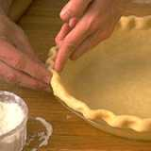
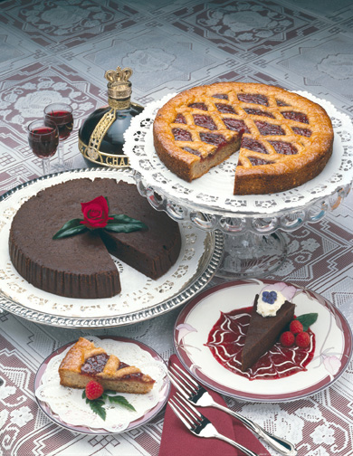

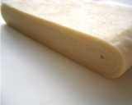
Solid Shortening
General Purpose, Emulsified, Laminating, Frying

Slide 27
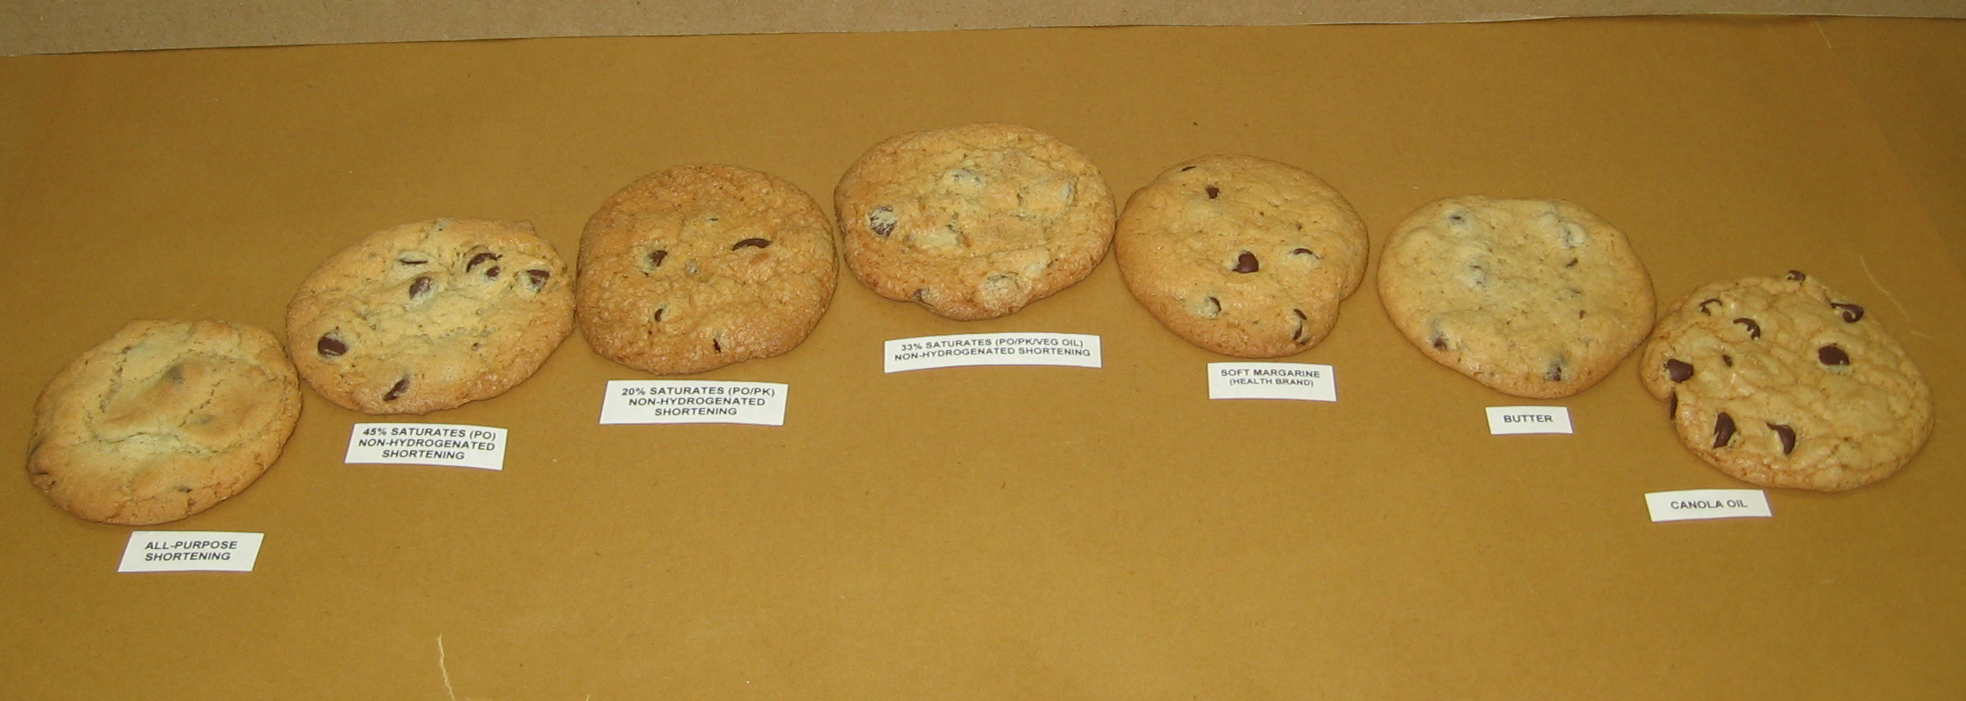
Solid Shortening
General Purpose Shortenings in Cookies

Slide 28
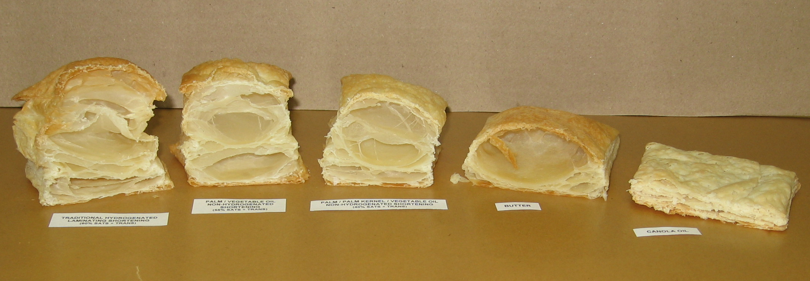
Solid Shortening
Effects of Various Fats in Lamination

Slide 29
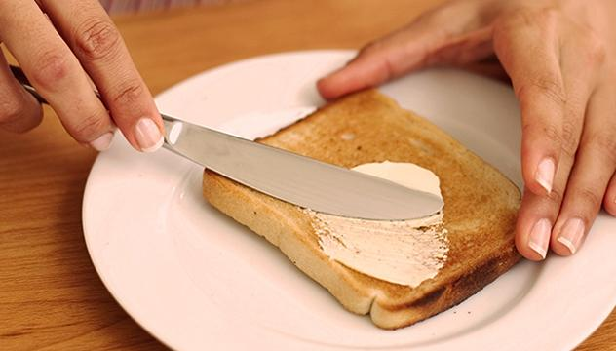

Margarine
Spreading
Sauteeing
Baking
Icing
Laminating

Slide 30
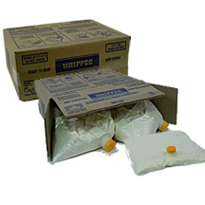
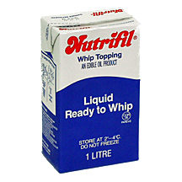
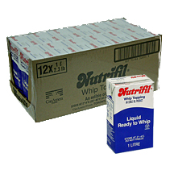

Whip Toppings
Non-dairy
Lactose free
Liquid, not frozen
No thawing, ready to whip
Stable foam

