Slide 1
Bunge North America

Slide 2
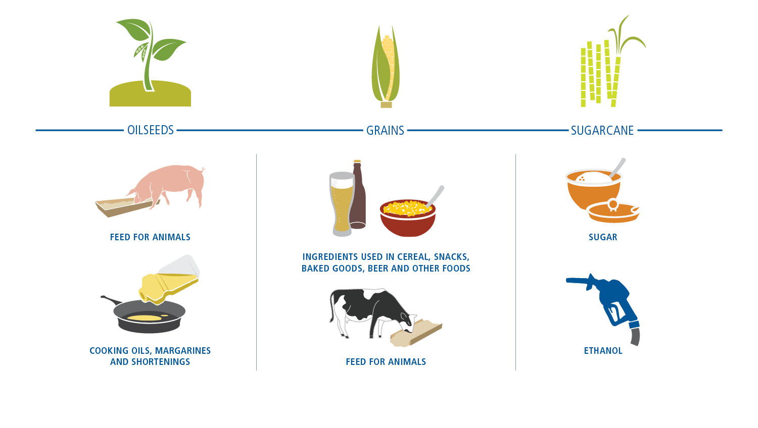

What We Do — Feeding and Fueling the World
Bunge processes oilseeds, grains, sugarcane and other agricultural commodities to make products and ingredients with numerous applications for customers worldwide.
Notes:
Now – to describe what we do:
Bunge brings food from where it is grown to where it is needed,
We buy, sell, store and transport crops, process them to make feed for animals, staple foods and ingredients, and other products.
And we partner with farmers, providing fertilizer and know-how, to help them produce larger and better harvests.
We also make renewable fuels that have less impact on the environment.
This slide shows you the range of commodities we handle.
[click]

Slide 3
Bunge Today
NET SALES
EMPLOYEES
$43.5 B
~35,000
FACILITIES
COUNTRIES
~400
~40⁺
Agribusiness
Food & Ingredients
Fertilizer
Sugar & Bioenergy
Leading producer of oils, margarines & industrial fats in the Americas and Europe
Growing oils position in Asia
Leading corn and wheat miller in the Americas
Fertilizer production and sales in Argentina
Fertilizer port operations in Brazil
21 mmt sugarcane milling capacity producing sugar, ethanol and electricity
Leader in global trade
and distribution
A global leader in oilseed processing
A global leader in grain and oilseed marketing
Notes:
Alberto mentioned that Bunge has a global, integrated and balanced portfolio.
To be specific, we have operations in all the major crop production and consumption markets, with more than 400 facilities in over 40 countries.
We also benefit from leading positions in key markets in agribusiness, food & ingredients and sugar & bioenergy.
And, we have a fertilizer business that is well scaled and focused.
[click]

Slide 4

Balanced Global Presence
Bunge Europe,
Middle East & Africa
Geneva
Bunge Limited
Bunge Global Agribusiness
White Plains
Bunge North America
St. Louis
Bunge Asia
Singapore
Bunge Brazil
São Paulo
Countries of operation
Regional headquarters
Bunge Southern Cone
Buenos Aires
Notes:
We are particularly proud of our asset network, which touches the world’s largest agricultural growth areas—North and South America, and Eastern Europe—and major areas of consumption growth—particularly Asia.
[click]
It is complemented by marketing offices, joint ventures and other commercial activities in additional countries.
[click]

Slide 5
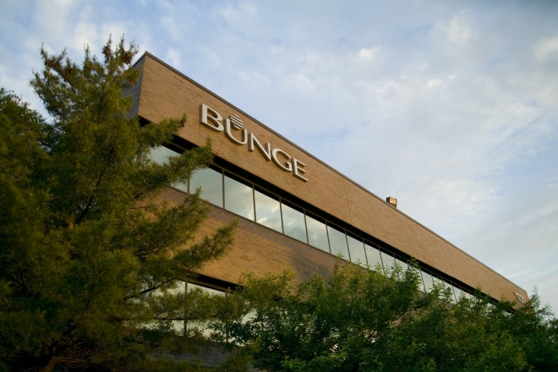
Bunge North America
EMPLOYEES
FACILITIES
~4,900
~125
COUNTRIES
^{Canada,} ^{Mexico, U.S.}
Agribusiness
Food & Ingredients
Sugar & Bioenergy
Leading handler of soybeans, corn, wheat, sorghum, canola and rice
Ports in New Orleans, Brunswick, Longview, Quebec City
Leading integrated processor in N.A.
Leading supplier to foodservice/processor companies
Largest corn dry miller
California rice miller
Mexico wheat miller
Strong innovation through BiiC
Investor in an ethanol facility in Iowa
Key merchant of ethanol/biodiesel
Strong participant in U.S.-Brazil flows
Bunge Overview
Notes:
In North America, Bunge operates in Canada, Mexico and the U.S.
Our 125 facilities include grain elevators, oilseed processing plants, packaging facilities, and corn, wheat and rice mills.
We also have port facilities in New Orleans, Georgia, the Pacific Northwest and in Quebec City on the St. Lawrence Seaway.
North America operates in three segments, Agribusiness, Food & Ingredients and Sugar & Bioenergy

Slide 6
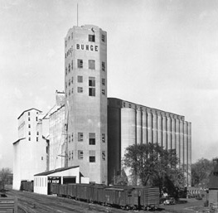

BNA: A Brief History
1923: Bunge North American Grain Corporation founded in New York City to trade raw agricultural commodities.
1935: Purchased first sizable grain facility, the Midway, near Minneapolis, moving from pure grain trader to full service grain company
1960s: Opened largest export elevator of its kind in Destrehan, La. in 1961, added soybean processing plant in 1967, taking a step down the food chain
1979: Expanded in food production with the purchase of Lauhoff Grain, making Bunge the largest corn dry miller
1980s: Bought three edible oil refineries entering value-added food processing and packaging markets
The Midway
Minneapolis, Minnesota
Notes:
Bunge is nearly 200 hundred years – we were founded in 1818 in Amsterdam by Johann Peter Bunge.
His grandson opened an office in Argentina in the 1880’s and the office in Brazil was opened in 1905.
Bunge opened a trading office in New York in 1918 and then incorporated in 1923 officially establishing our North American presence.
In 1934, we moved from grain traded to a full service grain company as we began to purchase elevators – this photo is of Midway, our first elevator, which is in Minneapolis. We sold it a number of years of ago and it has been converted into condos.
We moved down the food supply chain in the 60’s, building our first soybean processing plant in Destrehan, La.
We continued down the food chain adding milling and oil packaging plants to our portfolio.

Slide 7
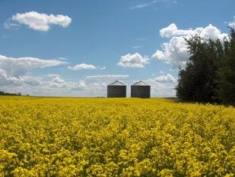
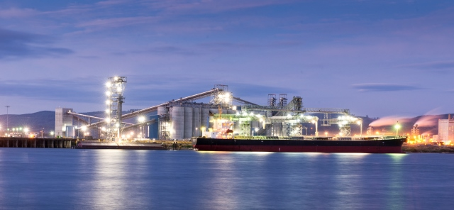
BNA: A Brief History
2002: Acquired Cereol, which included Central Soya in the United States, CanAmera Foods in Canada and extensive assets in Europe
2006: Entered the North American biofuels sector as a strategic investor
2010: Acquired California rice mill, BNA’s first entry into this market
2012: EGT (joint venture with ITOCHU) began exporting from newly constructed U.S. export terminal on the Columbia River.
2013: Purchased wheat milling assets of Grupo Altex, tripling our size in Mexico.
2015: Created joint venture with SALIC to invest in CWB in Canada
Notes:
We established operations in Mexico in 1997 with an investment in Harinera La Espiga, the largest wheat mill in the Spanish speaking Americas. We now own 100%.
One of the most significant events in Bunge’s history occurred in 2001 – the company, which had been privately held, went public on the New York Stock Exchange. The funds raised in the IPO, were used to purchase Cereol, a global agribusiness company which established our presence in Canada and expanded our operations in the Eastern half of the U.S.
Our biofuels presence has been small but strategic. We are an investor in an ethanol facility in Council Bluffs, Iowa – called SIRE (Southwest Iowa Renewable Energy). But participating in this way we understand the way the biofuels industry has impacted commodity flows.
Added rice milling to our food & Ingredients portfolio with the purchase of a mill from Anheuser-Busch
One of Bunge’s most significant recent investments is EGT, an export terminal in Longview, Washington with 3 supporting shuttle loaders in Montana. The investment reflects the growing demand for commodities in Asia.
Our most recent investment tripled our size in Mexico -- the wheat milling assets of Grupo Altex includes six mills which blend will with the existing La Espiga mill.

Slide 8
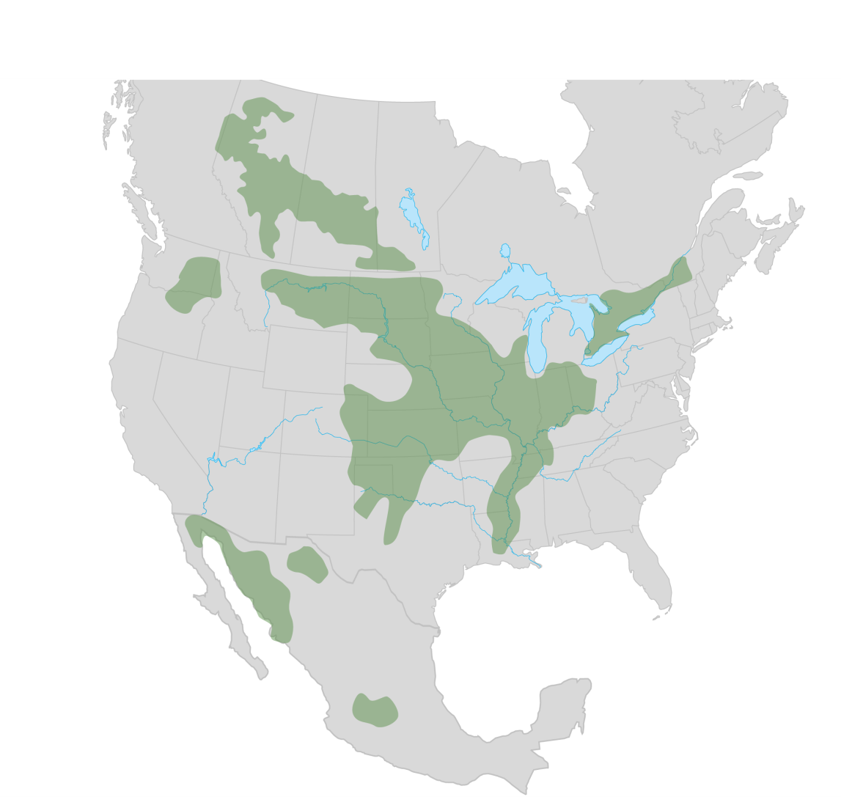
Bunge North America
  Key Growing Regions

Slide 9
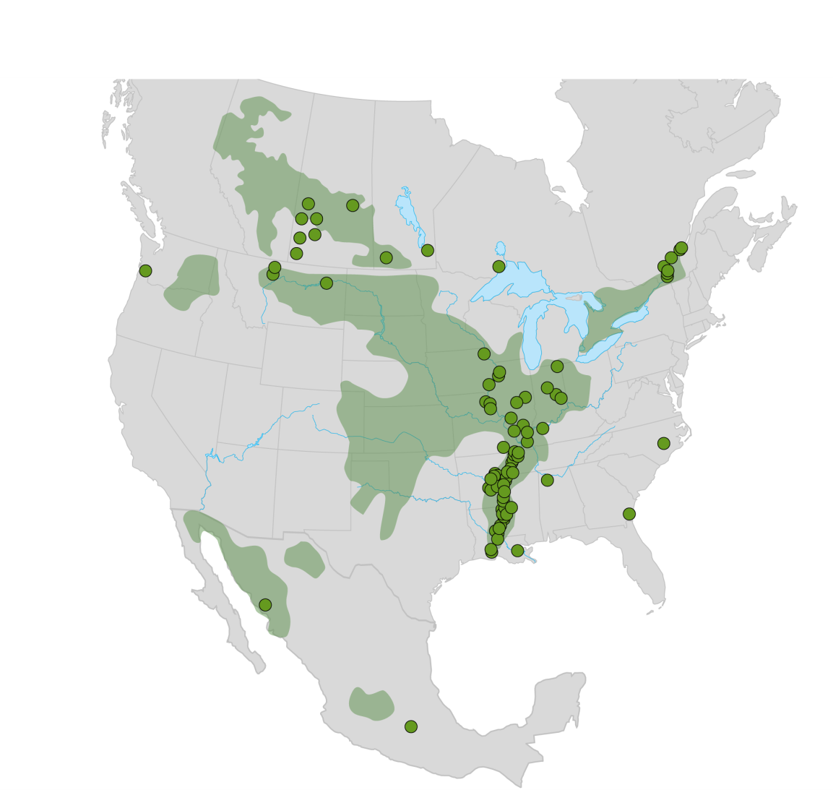
Bunge North America
  Grain Origination 25 MMT

Slide 10


Bunge North America
  Grain Origination 25 MMT
  Export 19 MMT

Slide 11
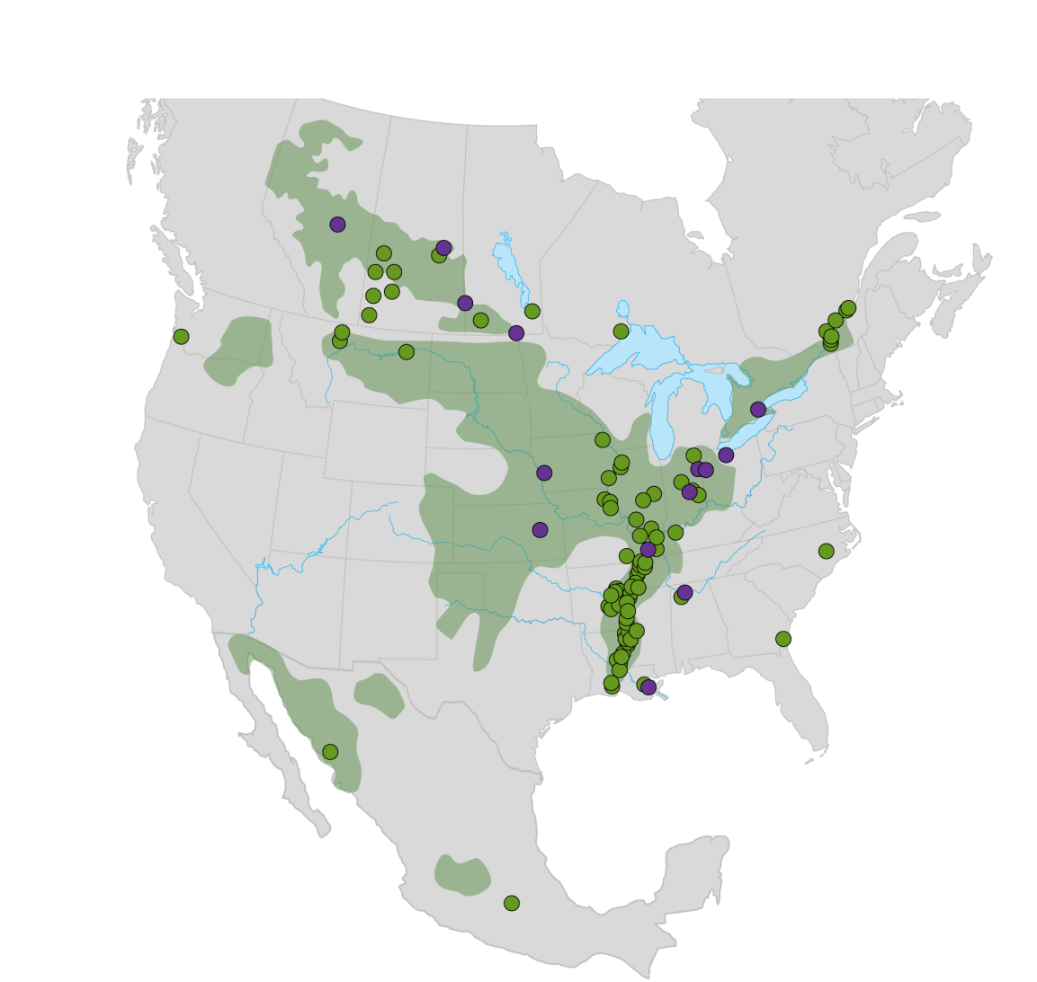

Bunge North America
  Grain Origination 25 MMT
  Export 19 MMT
  Processing 15 MMT

Slide 12
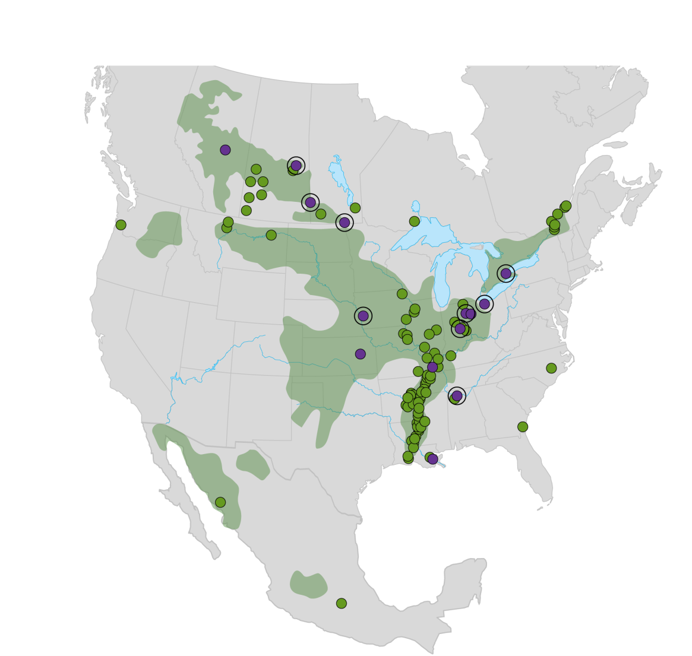

Bunge North America
  Grain Origination 25 MMT
  Export 19 MMT
  Processing 15 MMT
  Refining 3 MMT

Slide 13
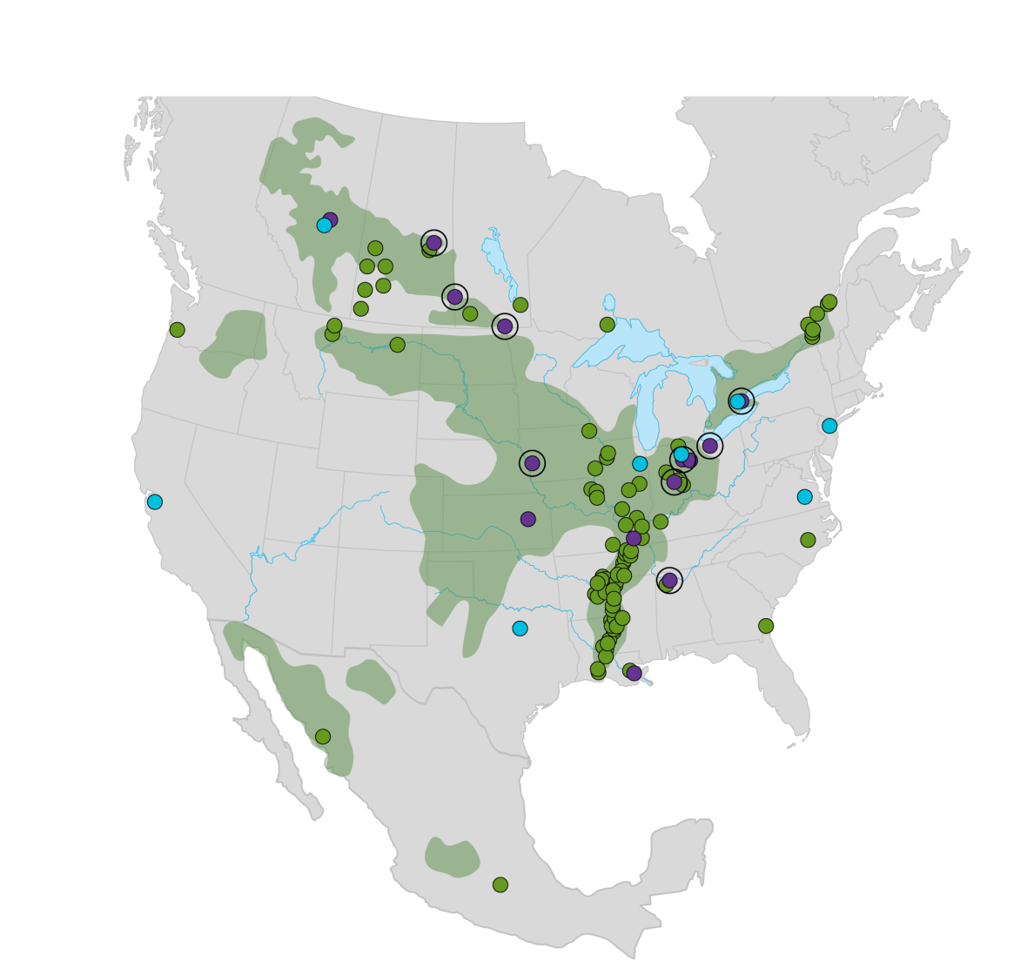

Bunge North America
  Grain Origination 25 MMT
  Export 19 MMT
  Processing 15 MMT
  Refining 3 MMT
  Packaging 1 MMT

Slide 14
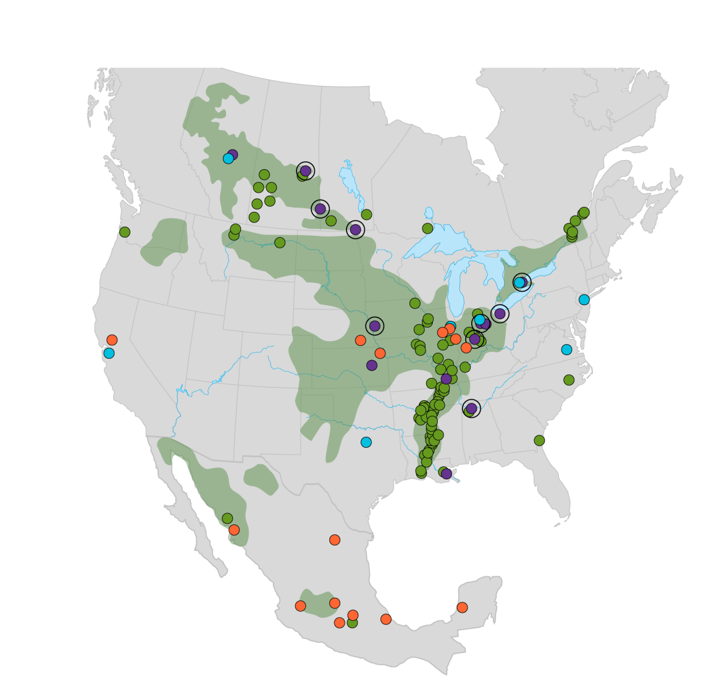

Bunge North America
  Grain Origination 25 MMT
  Export 19 MMT
  Processing 15 MMT
  Refining 3 MMT
  Packaging 1 MMT
  Milling 3 MMT

Slide 15


Best integrated agrifood company, focused on oilseeds and grains
Stand for Safety
Right Balance
Best in Class
Winning Footprint

Slide 16
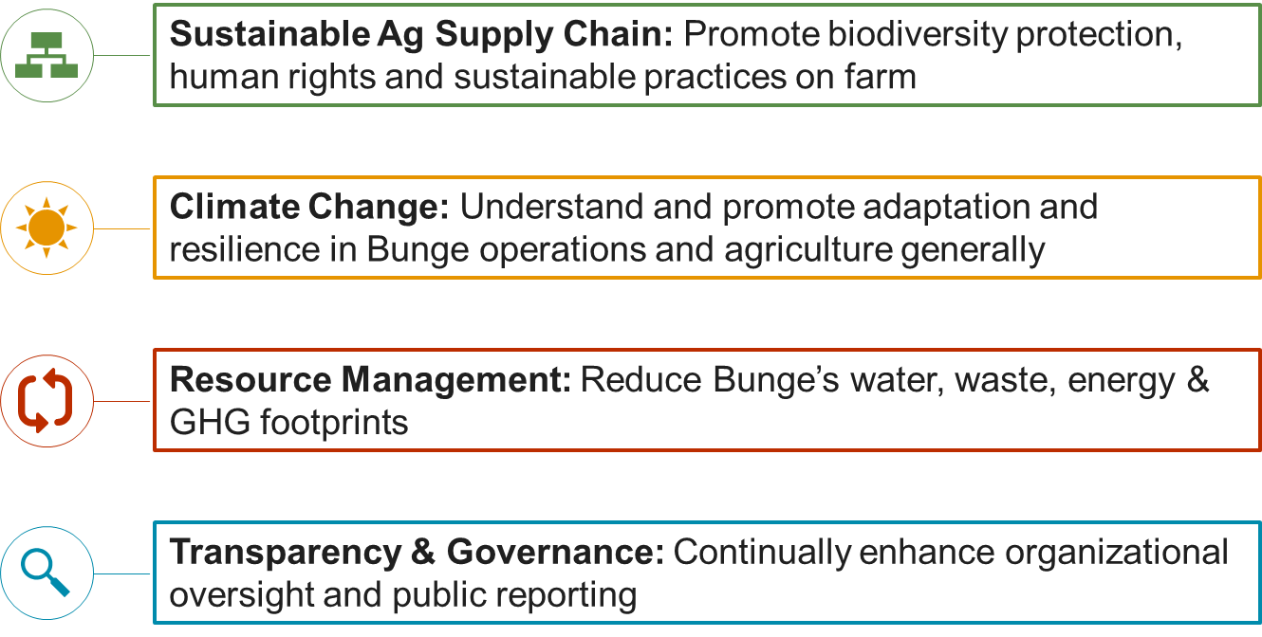
Sustainability Strategic Pillars

Slide 17
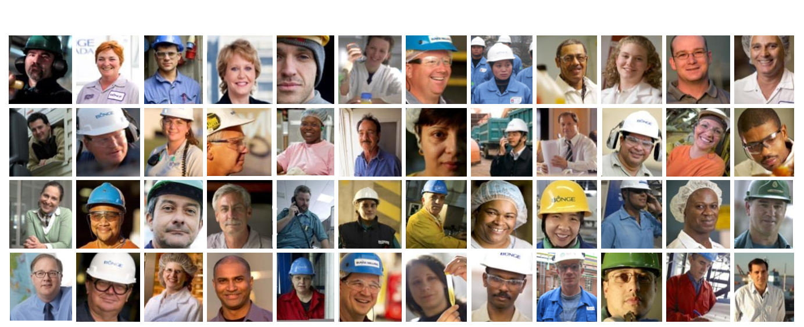
Diversity & Inclusion

Slide 18


Four Critical Behaviors

Slide 19

Bunge – 200 years
and just getting started

